Slide 1

Interpreting ASL for Bot control using Neural Networks
Team Mira:
Manojna Sistla
Revathy Venkatesh
Srinidhi Parshi
Naga Nikitha Kakani

Slide 2
Idea and Objective:
What is ASL??
Developed a system which makes life a little easy for such people.
Control the motion of the robot as per the ASL commands.
Extension to the idea: Full pledged support system for remote access.

Slide 3
Tasks Performed:
Training a Neural Network for ASL recognition
Transfer the inferenced data using the Bluetooth module
Controlling motion of the bot using the transferred ASL commands
Live detection of gestures using Neural Compute stick

Slide 4
Hardware Components:
Arduino Uno
L293D Motor Driver IC
HC-05 Bluetooth Module
Neural Compute Stick
Raspberry Pi

Slide 5
Training the Neural Network:
TensorFlow Framework
Mainly used to classification, perception, Understanding, and prediction.
Inception v3 Model
Used for image recognition and is proved to achieve the highest accuracy compared to other models like keras.
Libraries Used:
OpenCV - Used for analyzing the video captured and image processing for detecting ASL gestures.
MatPlotLib - Used to create figures and plots. We used this library to get a frequency analysis of the probability that we got as results.
NumPy - Used to do mathematical operations on multi-dimensional arrays. We used this to perform MAC operations on multi-dimensional image arrays.

Slide 6
Work Flow:
Transfer Learning: Retrained the Inception model for recognition of ASL using the ASL data set.
In NN, neurons organized in layers. Different transformation like Regularization, normalization, sigmoid function etc.
Pre-processing of Images- In this step we will classify each images and put it into the respective sub folder.
Retraining the bottleneck and fine-tuning the model: we will train a new top layer which is called the bottleneck layer which can recognize specific classes of images.
The other layers like Softmax layer are trained on top of this layer.
We will get trained graph at the end of the process with respective weights for each label.
Inference or validation: We used the trained graph obtained in the above step to do the inference and obtain the results by giving different images.
We also used webcam to record the live video and then use the trained graph to infer each gesture

Slide 7
Inference on Edge:
Neural Compute stick:
A USB like visual processing unit
used for developing, fine tuning and deployment of Deep Neural Networks (DNNs) in a power constrained environment.
NCSDK:
Contains set of software tools to compile, validate and profile neural networks
Modes:
Full system
API
Supported Frameworks: Caffee or TensorFlow

Slide 8
Execution steps:
Clone TensorFlow™ source code and TensorFlow™ model repositories
Download and extract the checkpoint file
Export GraphDef file
Freeze model for inference
Compile the Movidius™ graph file

Slide 9
Issues Faced:
Environmental constraints
Memory constraints
Lack of proper reference material

Slide 10
Bluetooth Interfacing & Bot Control:
HC-05 Bluetooth module is used to establish a connection between the ASL detection system and the robot.
Using the transferred commands inferenced by the neural network, bot motion is controlled with Arduino Uno board.

Slide 11

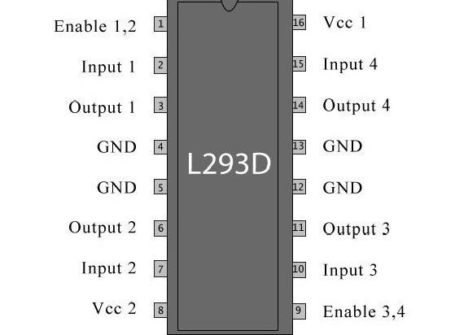
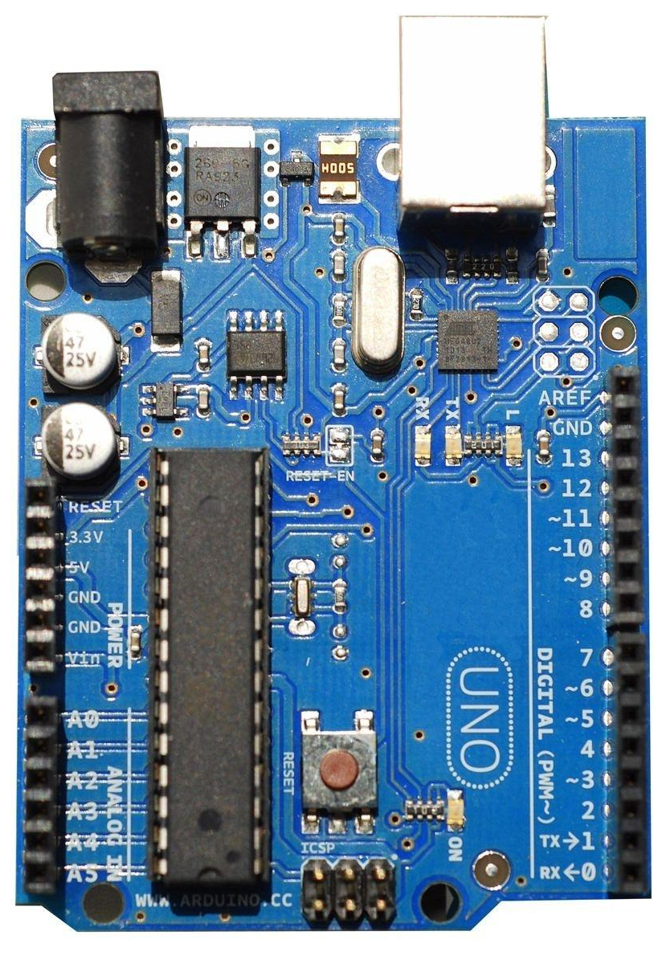
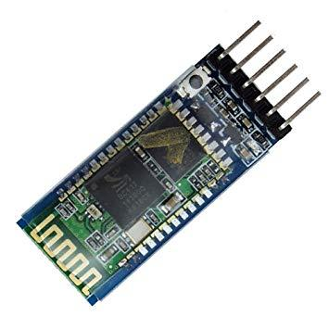
Components used

Slide 12
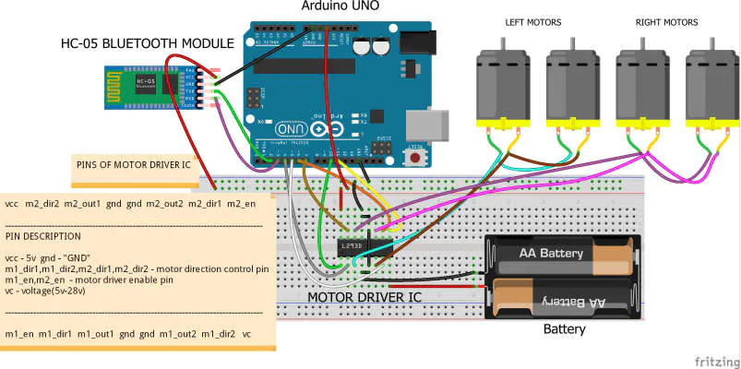
Arduino and Bluetooth Circuit
Source: https://create.arduino.cc/projecthub/theSTEMpedia/4-wheel-robot-made-with-arduino-controlled-using-dabble-4650f7

Slide 13
Video demo Links:
Introduction & Description:
IntroductionAndDescription
Commands, Forward and Backward Movement of Bot:
Bot_Motion1
Left and Right movement of Bot:
Bot_Motion2

Slide 14
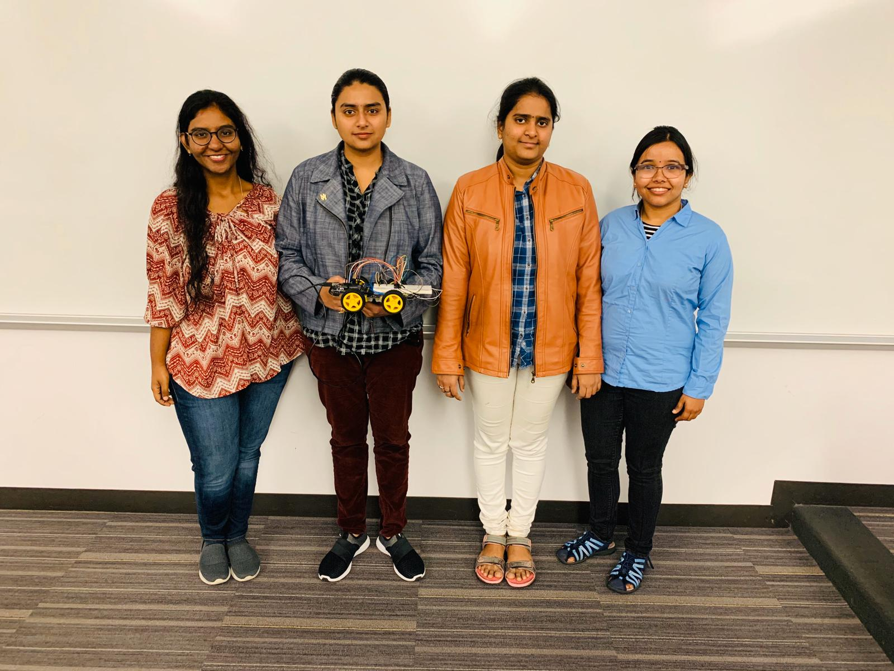
Thank you

